Slide 1

Automated Fraud Detection using Alternative Data
Traditional fraud detection methods rely heavily on historical transaction data. However, emerging fraud patterns often go undetected, leading to financial losses and high false positive rates. AI-driven analysis of alternative data sources can enhance fraud detection capabilities.

Slide 2

AUG3: Enhancing Fraud Detection with Alternative Data
This new system leverages AI to analyze diverse data sources. It goes beyond traditional transactions to incorporate social media activity, browsing history (with consent), geolocation, and device information. The
alternative data market is predicted to grow 40% annually by 2025.
Diverse Data
AI-Powered
Analyze more than just transactions.
Detect hidden fraud patterns.
Future Growth
Market expansion by 2025.

Slide 3

Alternative Data Sources: A Deeper Dive
Alternative data sources provide a more comprehensive view. They include social media for sentiment analysis, browsing history for online behavior patterns, geolocation to verify transaction locations, and device information for identification. These sources can reveal suspicious activities and predict fraudulent behavior.
Social Media
Sentiment analysis and profile verification.
Browsing History
Website visits and search queries.
Geolocation
Transaction location verification.
Device Information
Device ID and operating system.

Slide 4
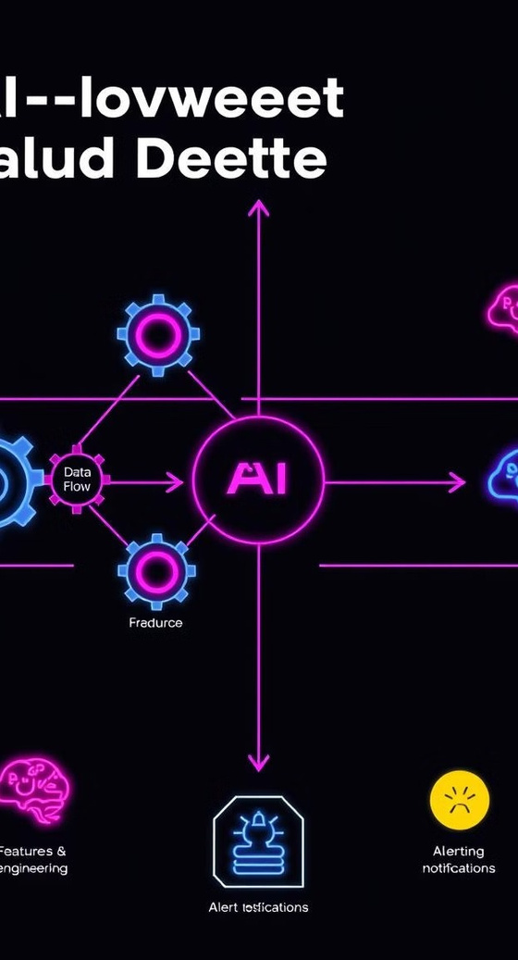
AI-Powered Fraud Detection System: Architecture
The architecture consists of secure data ingestion pipelines, AI-driven feature engineering, real-time machine learning models, and prioritized alerting. The system is designed for continuous learning through model retraining every three months. This maintains efficacy against evolving fraud tactics.
1
Data Ingestion
Secure data pipelines.
2
Feature Engineering
AI-driven fraud indicators.
3
Machine Learning
Real-time fraud scoring.
4
Alerting & Reporting
Prioritized alerts.

Slide 5




Key Technologies and Techniques
The system employs Natural Language Processing (NLP) for sentiment analysis. Machine Learning (ML) is used for anomaly detection and classification models. Deep Learning (DL) enables complex pattern recognition. Real-time data streaming is facilitated by Apache Kafka, processing 100k messages per second.
NLP
ML
DL
Kafka

Slide 6
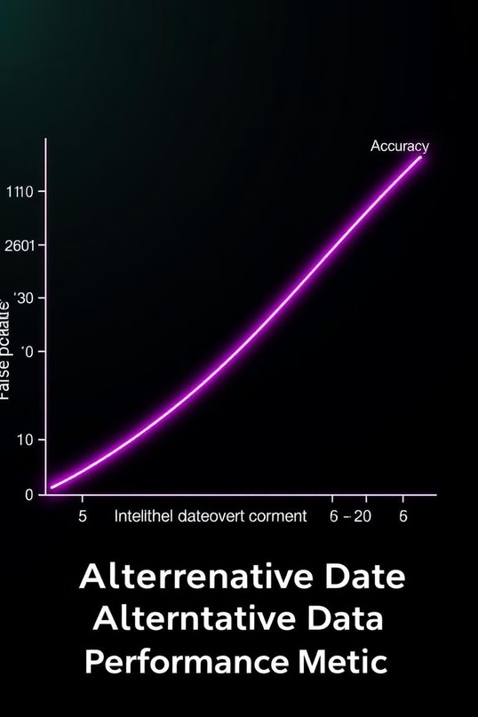
Reducing False Positives and Improving Accuracy
Integrating alternative data can reduce false positives by 30%. Precision is increased by 20%. Customer satisfaction improves through fewer unnecessary fraud alerts. For instance, geolocation can confirm legitimate transactions when a user is traveling abroad.
30%
False Positives Reduced
20%
Precision Increased

Slide 7
Implementation and Scalability
The system utilizes a cloud-based infrastructure (AWS, Azure, GCP) for scalability. Compliance with data privacy regulations (GDPR, CCPA) is ensured. It can process 10,000 transactions per second in real-time. API integration with existing fraud management systems is seamless.
Cloud Infrastructure
Compliance
AWS Azure GCP
GDPR CCPA

Slide 8
Conclusion: Transforming Fraud Detection
AI-powered analysis of alternative data enables proactive fraud prevention. It reduces financial losses and improves customer experience. Continuous innovation is essential to adapt to evolving fraud threats. The future roadmap includes incorporating advanced AI techniques like federated learning.
Enhanced Security
Proactive Prevention
Continuous Innovation
2
1
3

